Slide 1



Master Thesis Seminar
Pedro Almeida
Academic Tutor: Dr. Frank Molkenthin
Institutional Tutor: Dr. Markus Sunela
20 June 2019

Slide 2
Content
Introduction to thesis topic
1
Methodology and Pilot Areas
2
Open Questions
3

Slide 3
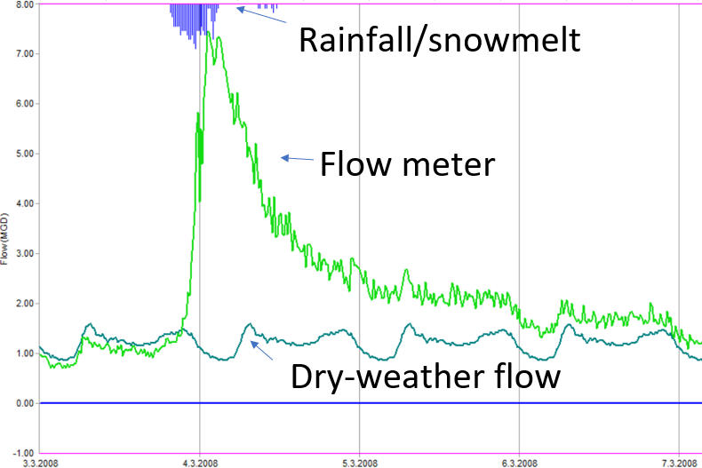
Task
Model Rainfall dependant Infiltration and Inflow
Higher flows in the network during and after rainfall.
Causes: Infiltration from direct runoff, inflow, groundwater, defects (pipe cracks, leaky connections, etc)
Hydraulic model: Dry-weather flow
Hydrological model: can be used to simulate wet-weather flow

Slide 4
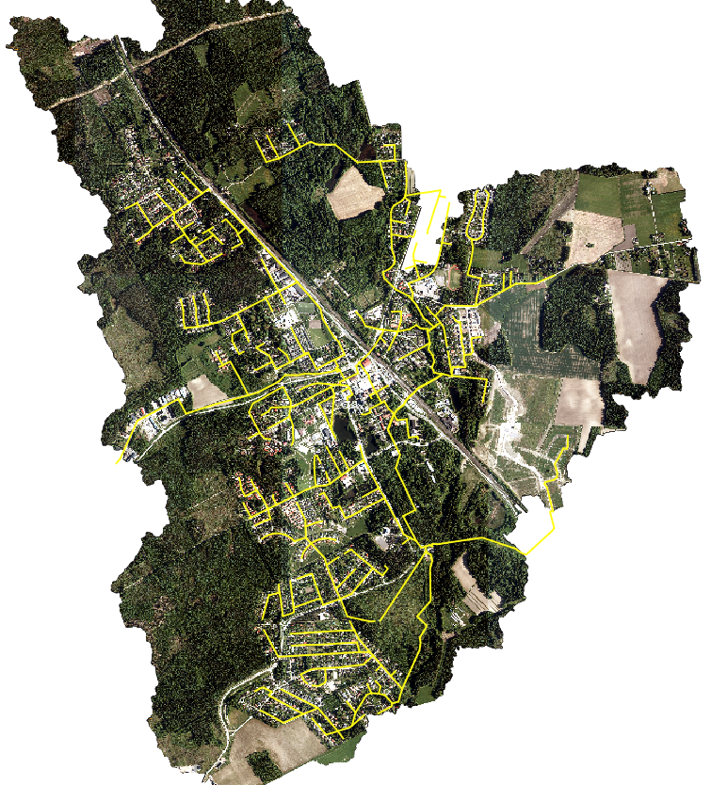
Continuous Simulation of Urban Sanitary Sewer Network in Cold Climate: Forecast and Automatic Calibration
Goals:
1. Create a hydrological model using EPA-SWMM. Describe the data used and methods to create the model.
2. Compare the use of SWMM modules (Groundwater and Snowpack) and R-T-K Unit Hydrographs separated when modeling wet-weather flows in sanitary sewers during all climate seasons.
3. Evaluate the use of automatic calibration procedure for the two methods identifying key parameters and its use for real-time applications.
4. Use open data weather forecast provided by the Finnish Meteorological Institute to simulate predicted flows in the sewer system using both methods and compare the results against real inflow data.
90% - Model done, but complete description needed for the thesis report
85% - More simulations with different calibrated parameters still to be done.
30% - Preliminar sensitivity analysis of parameters done, but further comparison and calibrations needed
50% - Description of the data collection and the use of open data available done, but validation of the calibrated models still to be carried. Waiting to see if I can get data from 2019 inflows.

Slide 5
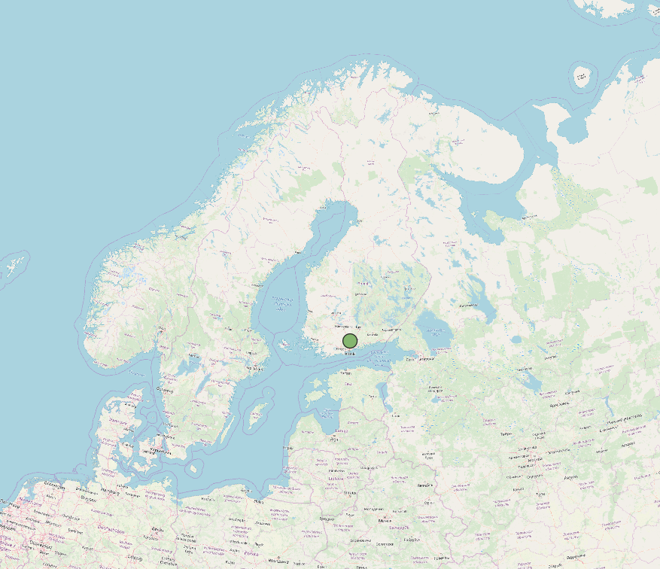
Study Area
Finland -> Southern Region -> Tuusula Municipaly -> Jokela Town

Slide 6
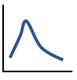
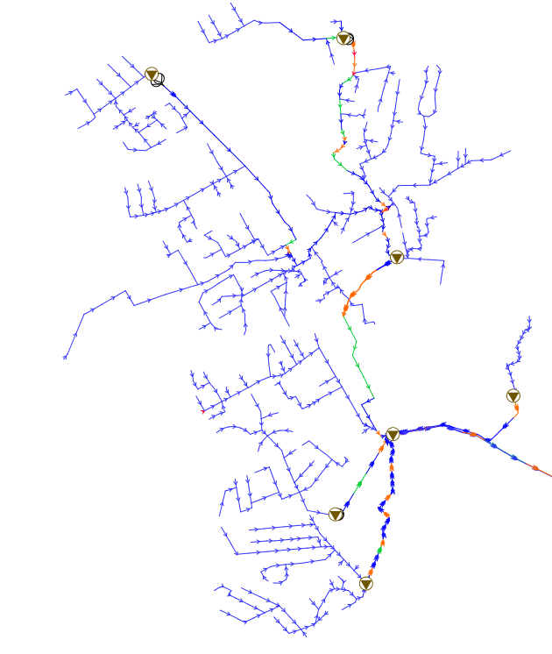
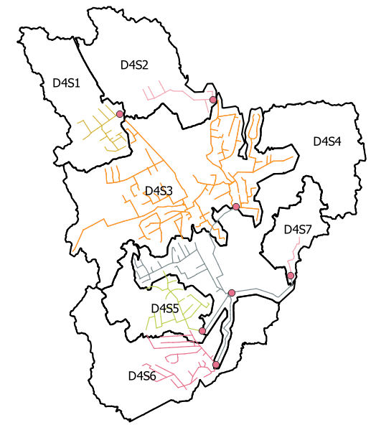
7 Pumping Stations
Measurements for 2018 in 2 pumping stations
Method 1:
Proposed 7 UH. One for each pumping station
Method 2:
7 subcatchments, one for each station
Further description of the network and catchment characteristics will be available in the final thesis report!!!

Slide 7
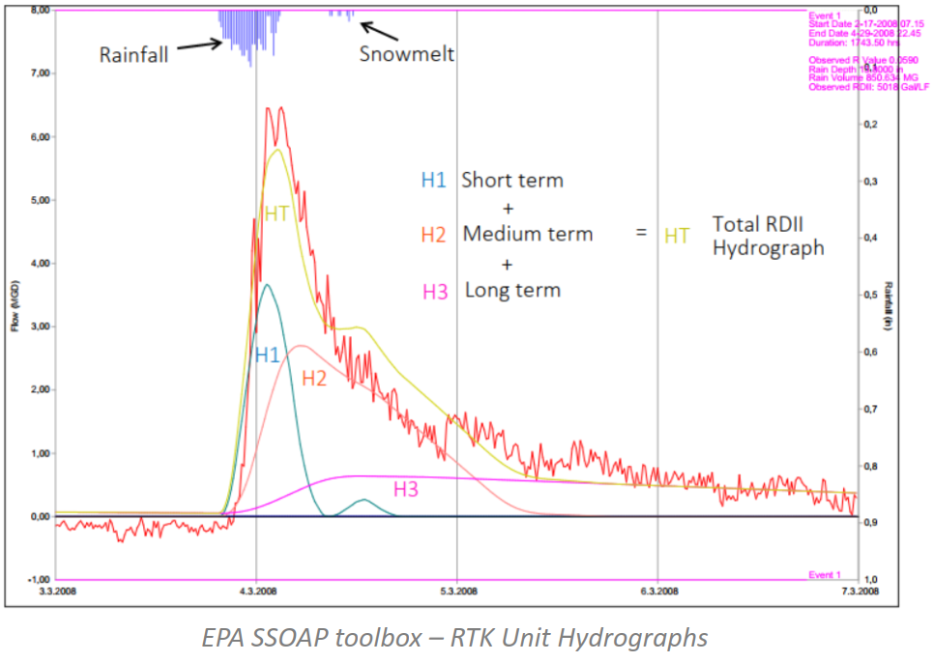
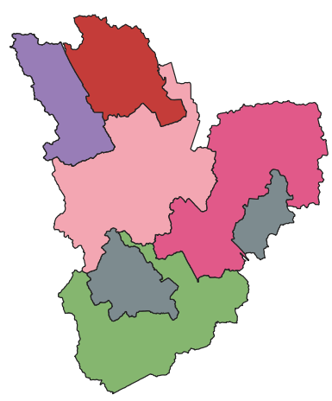
Hydrological Model
Physically-Based
R-T-K Unit Hydrographs
Groundwater
Snowpack & Melt
Runoff
Climatology
Infiltration

Slide 8
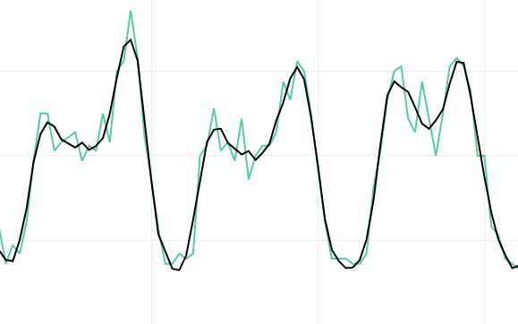
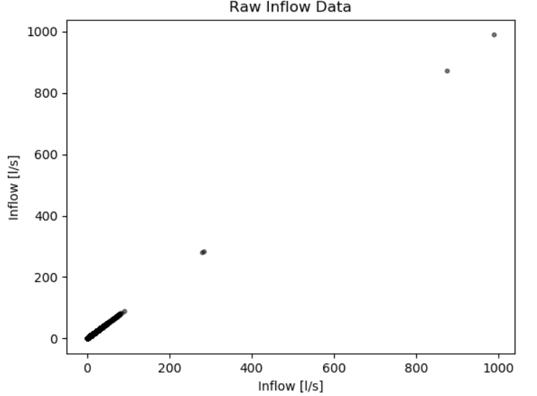
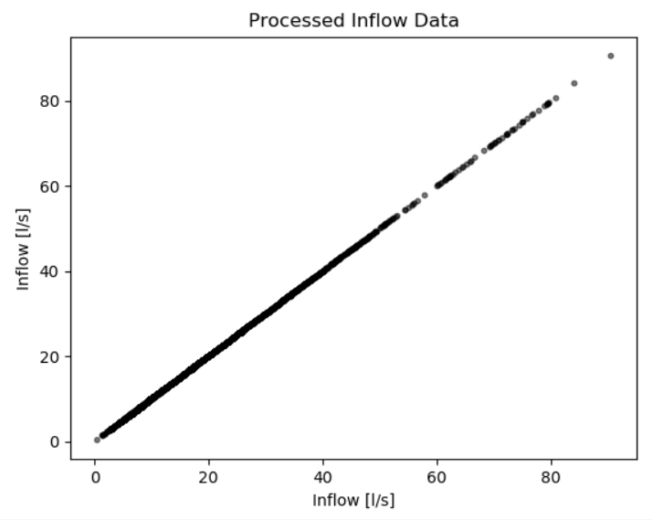
Inflow Data Pre-Processing
1. Removal of outliers, detection of missing date: dates and measurements, and “filtering” the noise.
https://plot.ly/~peco20/2.embed
Outliers

Slide 9
Parameters Required per sewershed:
Physically-Based
RTK Hydrographs
SNOW PACK
Min Melt Coefficient (x3)
Max Melt Coefficient(x3)
Base Temperature(x3)
Frac. Free. W. Capacity(x3)
Initial Snow Depth
Initial Free Water
Depth at 100% Cover(x3) Total: 17
RUNOFF
Area
Width
Slope
%imperv
N-imperv
N-Perv
Dstore-Imperv
Dstore-Perv
%Zero-imperv
Subarea Routing
Percent Routed
Total: 11
SNOW MELT
ATI weight Frac
Dividing Temp
Negative Melt Ratio
Elev. Above MSL
Latitude
Longitude correct
Total: 6
Short-Term
R short T short K short Dmax short
Drec short
Do short
Medium-Term R medium T medium K medium Dmax medium
Drec medium
Do medium
Long-Term
R long T long K long Dmax long
Drec long
Do long
GROUNDWATER
Porosity Wilting Point Field Capacity
Conductivity
Conductivity Slope
Tension Slope
Upper Evap. Fraction
Lower Evap. Depth
Lower GW Loss Rate
Bottom Elevation
Water Table Elevation
Unsat. Zone Moisture Equation for GW flow
Total: 13
INFILTRATION
Max. Infil. Rate Min. Infil. Rate
Decay Const.
Drying Time
Total: 4
Total number: ~ 51
Total number: 18
Notes:
Physically-based: other processes being modeled. They are runoff, snowpack + snowmelt, groundwater and infiltration. Total number of approx. 51 required parameters. (key parameters need to be chosen for calibration. RTK: idea of sum of combining 3 unit hydrographs. Total of 18 parameters (all can be input to a calibration algorithm)

Slide 10
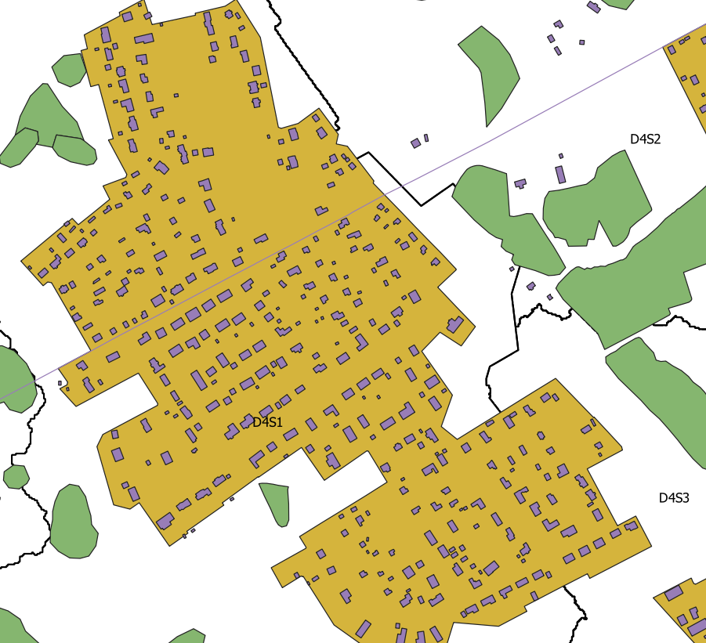
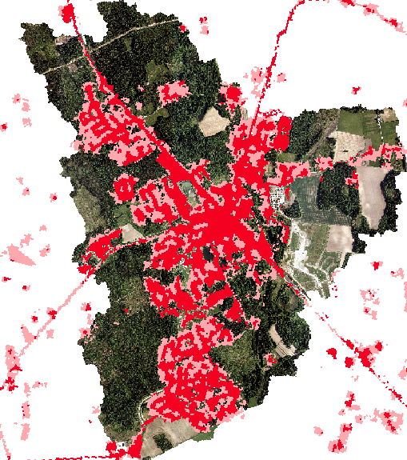
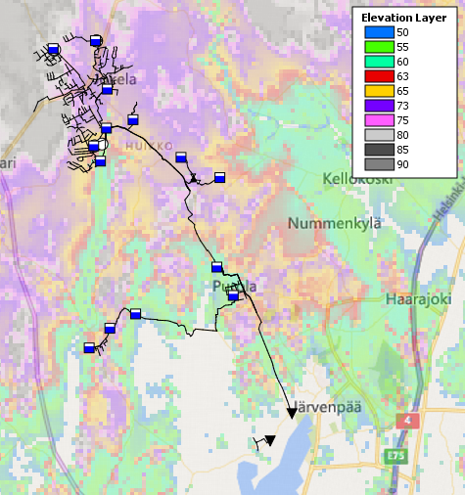
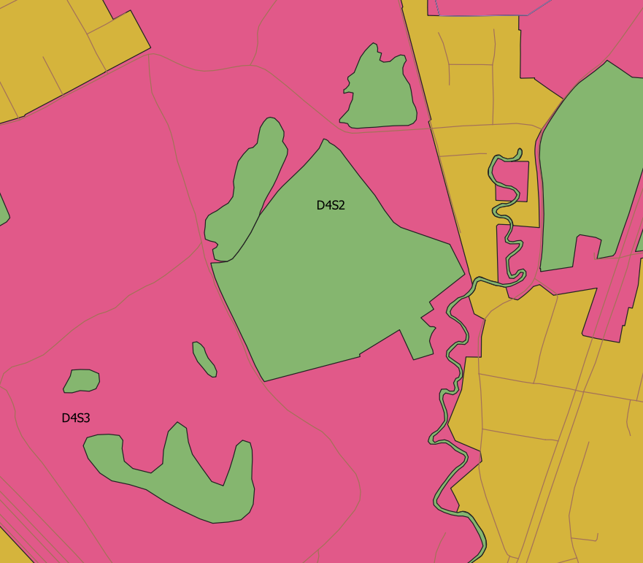
DEM (NLS)
Percent of Imperviousness (UA)
Land USE (NLS)
Soil type (SYKE)
Notes:
DEM, imperviousness raster, land use, soil properties and literature proposed parameters were defined for the SWMM subcatchments

Slide 11
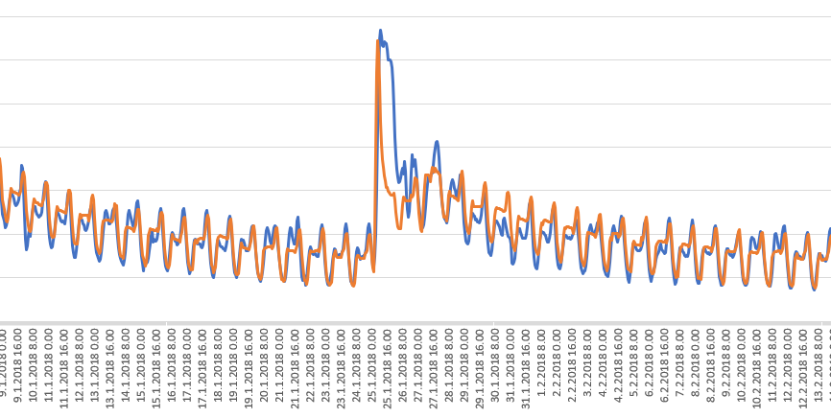
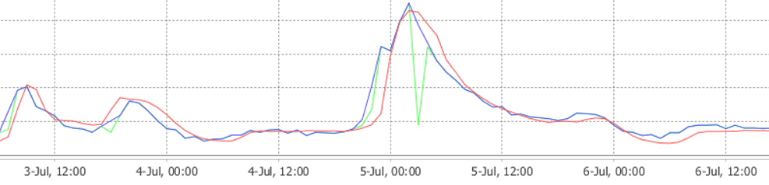
Calibration results: On going
Physically-Based
RTK Hydrographs
Simulated
Simulated
Measured
Measured
Notes:
Preliminar results of calibration: physically based has all the modules:

Slide 12
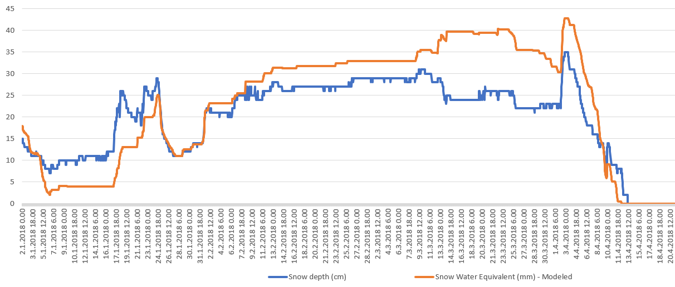
Snow Pack

Slide 13
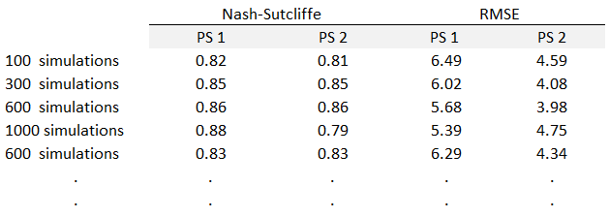
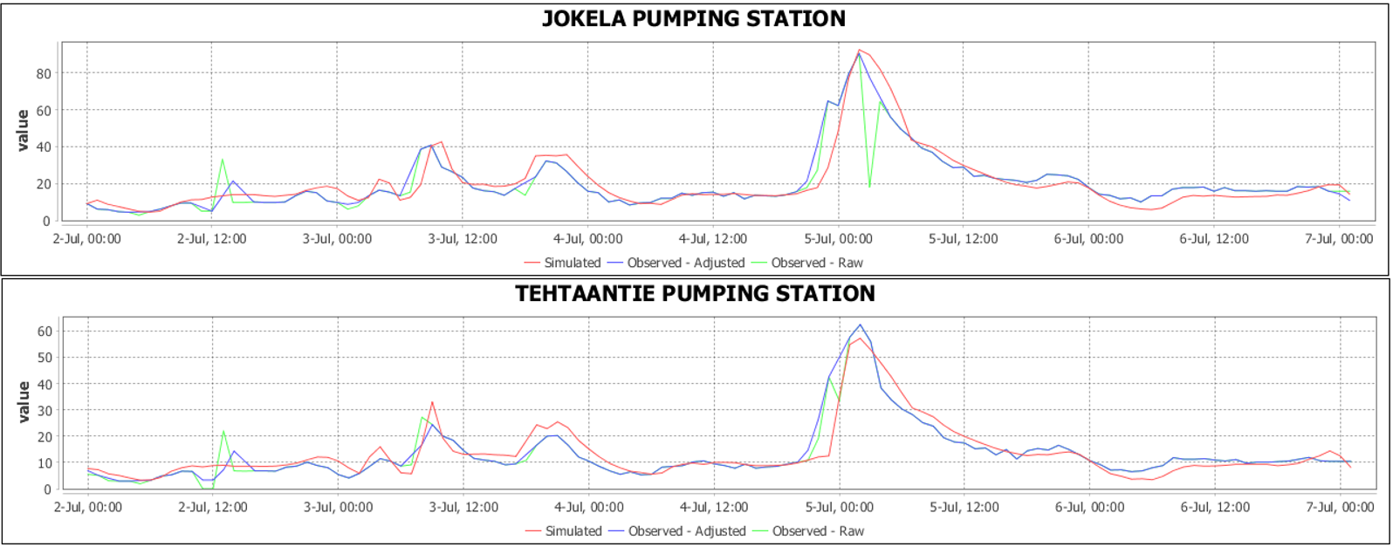

Slide 14
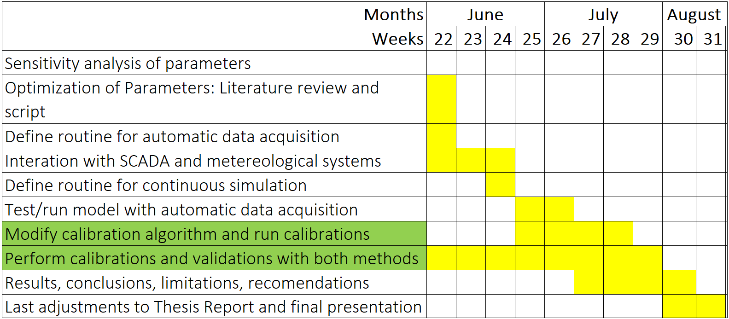
Interation with SCADA: Will not be Done for the thesis
Fetch data from API and write as input for the model: Done
Delayed: Only partially done
Directly connected to the interval of precipitation input. For the case of FMI open data this is every 6h: Done
As the automatic data acquisition is ready: Done
At the moment...
Preliminar results of calibration using DDS specific rain event

Slide 15
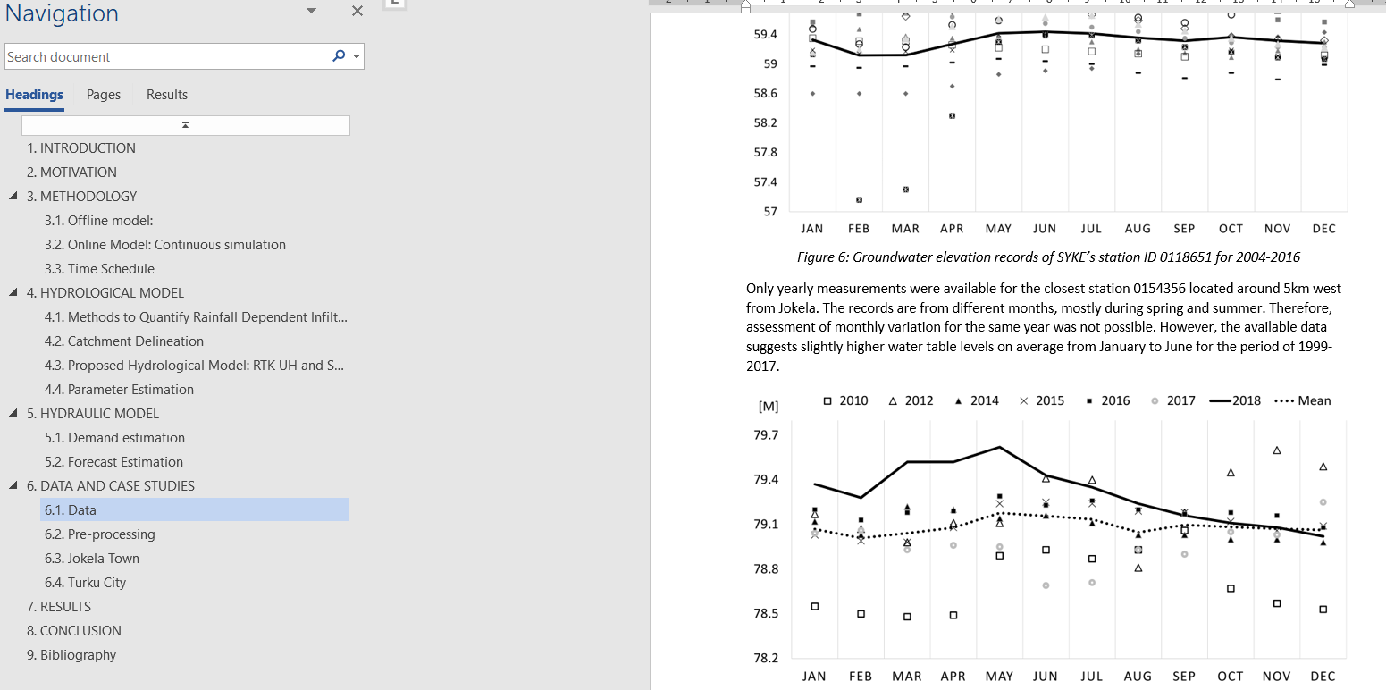
Thesis report status:
*Send draft by 2nd week of July.
*19th – 21st August.
Around 20 ”messy” pages
* Objectives in the intro.
*maybe include references at the beginning of each paragraph
* Put mot as part of introd.
* Maybe add literature review as a different chapter?.
*include discussion of the results..(can take time, start soon)
* Describe alternatives..
*Conclusion: summary – evaluation

Slide 16
Expected...
The reader should get a ”good” idea of:
- The process of creating a SWMM model
- The sensible parameters for calibration
- Advantages and Disad. Of R-T-K and PB for real-time application
- The use of calibration algorithm and a method to reduce SS
- Use of open data from Finnish/EU inst. (more location specific)

Slide 17
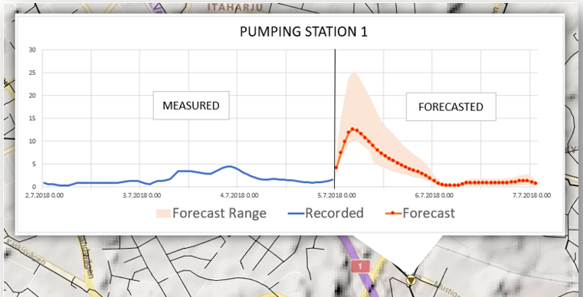
Physically-based or R-T-K UH? Depends...
...What is the purpose of the model?
R-T-K faster to build and less data to be processed
PB can provide also information on other processes such as infiltration, groundwater and snowpack
My opinion: Use both!
Notes:
Purpose: R-T-K Faster, PB more complete model Planning (offline model) or operations (online) model. I believe we are moving forward from not only using model for planning but also real-time operations providing information such as this graph with real-time flow measurements from SCADA system and prediction of future flows with hydrological models using weather forecasts. My opinion is to use both. Maybe start from the easiest such as the R-T-K, then PB, then couple both. This is the best way to get the future flow falling within the forecast range. This is the same method weather forecasts are used: an ensemble of different models that work together to provide the information we need.

Slide 18
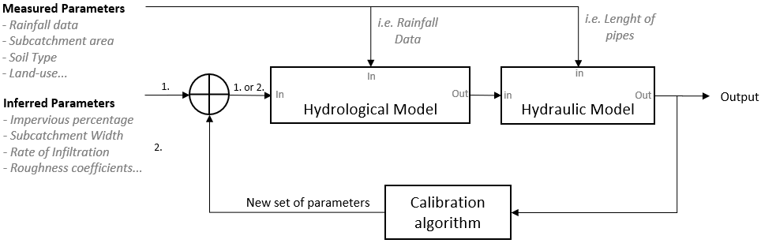
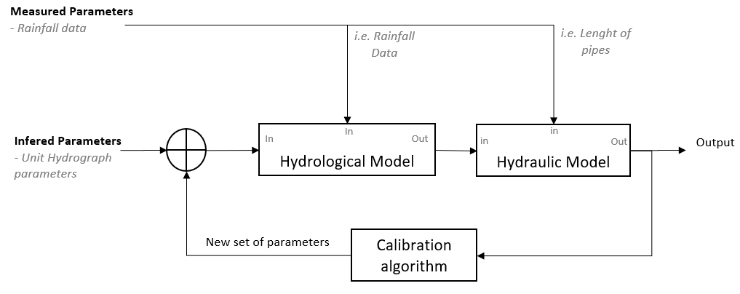
Physically-Based:
RTK Unit Hydrograph:

Slide 19
Input Data:
Physically-Based
RTK Hydrographs
Input Data
DEM
Land Use
Soil type
Windspeed
Evaporation
Temperature
Precipitation
Total: 7
IC
Snowpack (x3)
Groundwater Table (x3)
Flows in the network
Total: ~7
Input Data
DEM (for area) Precipitation
Total: 2
IC
Flows in the network
Total: 1
Total number: ~ 14
Total number: 3

Slide 20
Key Differences
Physically-Based method:
”data hungry” in comparison to R-T-K unit hydrograph
Model four different processes happening in the sewershed
Time consuming and require more data for real-time app
R-T-K Unit Hydrograph:
Less data required when comparing with PB method
Use a transfer function for precipitation fraction
Needs input of the snowmelt
Both require input data to be processed
Both need flow measurements for calibration and validation
Both models do not have any information of the defects in the network and use methods to approximate the leakage infiltration

Slide 21
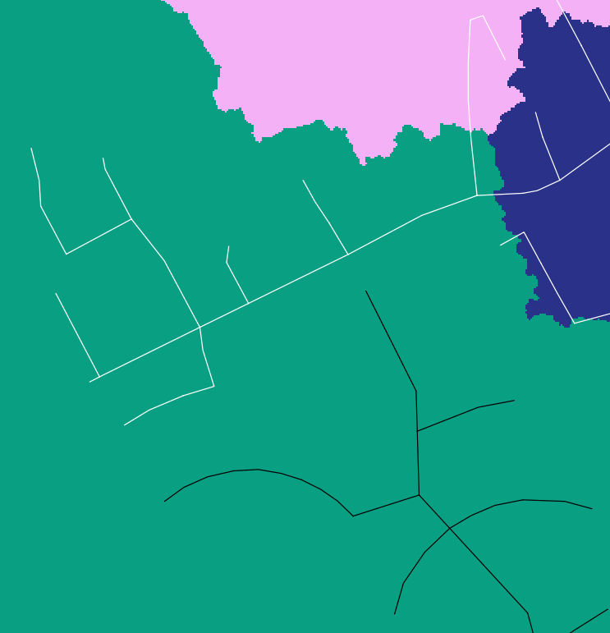
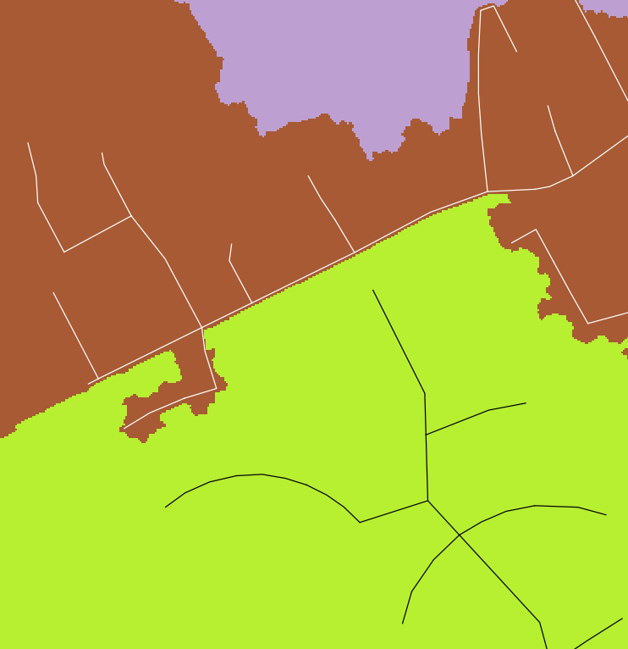
Burned x Filled DEM
Filled DEM
Burned DEM
Network of PS 1
Network of PS 2

Slide 22
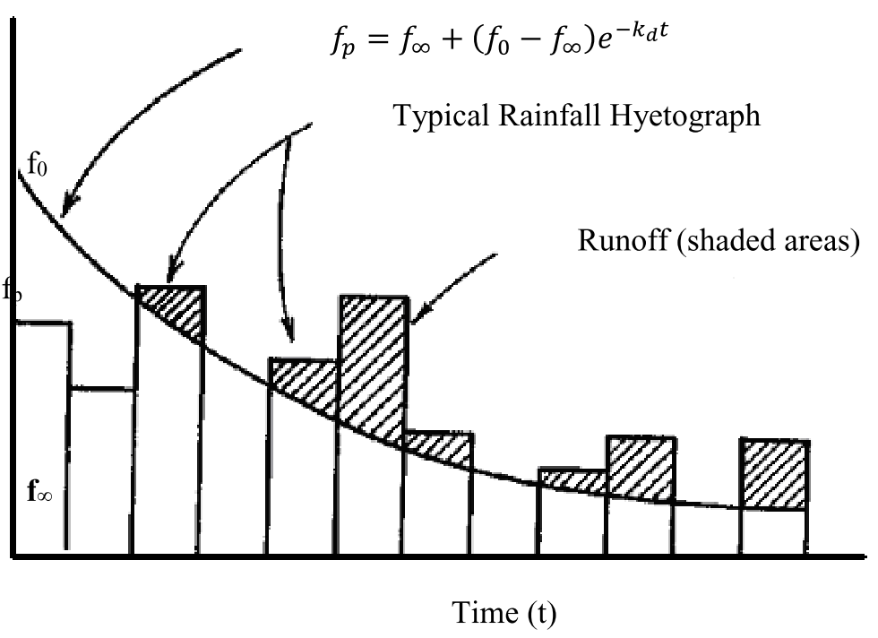
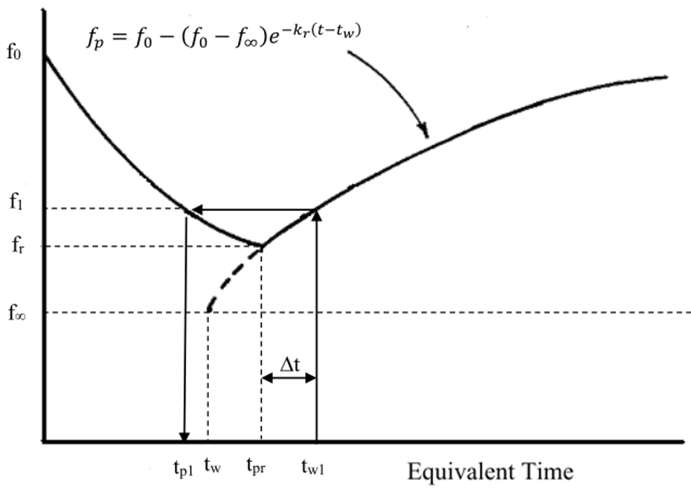
Horton Infiltration
INFILTRATION CAPACITY DECAY CURVE
INFILTRATION CAPACITY RECOVERY CURVE

